Slide 1
INTERNAL AUDIT TRAINING ISO 14001:2015
)
Support MSCi

Slide 2

INTRODUCTION
DELEGATE INTRODUCTION
Name & Qualification
Total work experience
Area of responsibility
Company & nature of business
Knowledge of EMS standard on 1 to 4 scale
Audit Experience (if any)
Expectation from this course

Slide 3

INTRODUCTION
LEARNING OBJECTIVE
To enable delegates to understand
Fundamental of EMS
Purpose of EMS in Business effectiveness
The requirements for the relevant Current standard
Processes and techniques for assessments and management of EMS
The benefits of its implementing
Planning & Conduction internal audit

Slide 4
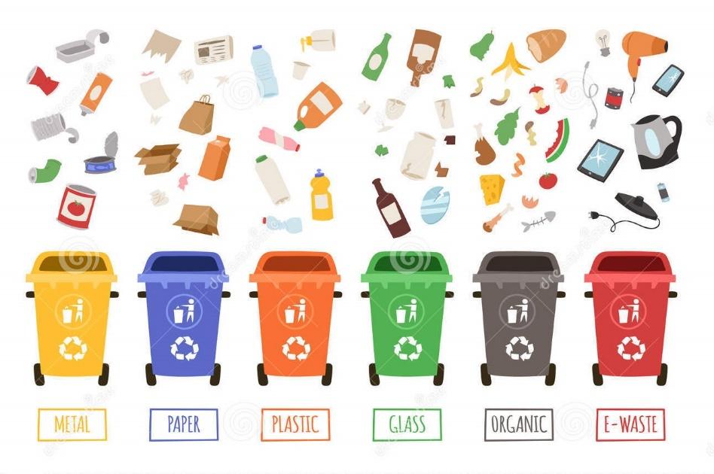
KEY AREA OF ENVIRONMENT AFFECTED
Air
Water
Land
Noise
Waste Management
Biodiversity
Ecosystem services
Climate changes
Protection of Environment will lead to:
Minimum harmful effect on environments Cause by its activities
Achieve continual improvement of its environmental performance

Slide 5
KEY CHANGES IN ISO 14001:2015
Strategic Environmental Management
There is an increased prominence of environmental management within the organization’s strategic planning processes.
A new requirement to understand the organization’s context has been incorporated to identify and leverage opportunities for the benefit of both the organization and the environment.
Particular focus is on issues or changing circumstances related to the needs and expectations of interested parties (including regulatory requirements) and local, regional or global environmental conditions that can affect, or be affected by, the organization.
Once identified as a priority, actions to mitigate adverse risk or exploit beneficial opportunities are integrated in the operational planning of the environmental management system.

Slide 6
KEY CHANGES IN ISO 14001:2015
2. Leadership
To ensure the success of the system, a new clause has been added that assigns specific responsibilities for those in leadership roles to promote environmental management within the organization.
3. Protecting the environment
The expectation on organizations has been expanded to commit to proactive initiatives to protect the environment from harm and degradation, consistent with the context of the organization. The revised text does not define ‘protect the environment’ but it notes that it can include prevention of pollution, sustainable resource use, climate change mitigation and adaptation, protection of biodiversity and ecosystems, etc.

Slide 7
KEY CHANGES IN ISO 14001:2015
4. Environmental performance
There is a shift in emphasis with regard to continual improvement, from improving the management system to improving environmental performance. Consistent with the organization’s policy commitments the organization would, as applicable, reduce emissions, effluents and waste to levels set by the organization
5. Lifecycle perspective
In addition to the current requirement to manage environmental aspects associated with procured goods and service, organizations will need to extend its control and influence to the environmental impacts associated with product design and development to address each stage of the life cycle, i.e. acquisition of raw materials, design, production, transportation/delivery, use, end-of-life treatment and final disposal. This does not imply a requirement to do a life cycle assessment.

Slide 8

GOAL OF Environment Management System.
The ability to consistently provide products and services that meet customer and applicable statutory and regulatory requirements
Facilitating opportunities to enhance customer satisfaction.
Helping organization to improve its overall performance and provide a sound basis for sustainable development initiatives.

Slide 9
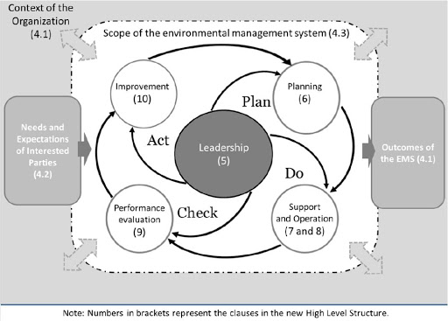
EMS PROCESS APPROACH-PDCA

Slide 10
PROCESS APPROACH-PDCA
PDCA is translated into the following
PLAN:
Understand the context of the organization, establish environmental objectives and processes necessary to deliver results in accordance with the organization’s environmental policy, understand risk and
opportunities and determine the support required to achieve the outcomes required.
DO:
Implement the
processes as planned
to include operational
planning and control
and emergency
preparedness and
response.
CHECK:
Monitor, measure and
Evaluate environmental
performance to include
internal audit and
Management Review.
ACT:Take actions
to continually
improve to include
addressing non
conformity.

Slide 11
PROCESS APPROACH
EMS RELATED PROCESSES IN ADDITION TO BUSINESS PROCESSES
Risk Analysis (Aspect/Impact)
Review & Monitoring of legal & other requirements
Emergency preparedness & Response
Waste management
Accident/incident investigation
Health monitoring
Work place monitoring

Slide 12

KEY DEFINITIONS
Management system: set of interrelated or interacting elements of an organization to establish policies and objectives and processes to achieve those objectives.
Environmental management system: part of the management system used to manage environmental aspects, fulfil compliance obligations and address risks and opportunities.
Top management:person or group of people who directs and controls an organization at the highest level.
Environment: surroundings in which an organization operates, including air, water, land, natural resources , flora, fauna, humans and their interrelationships.
Environmental aspect: element of an organization’s activities or products or services that interacts or can interact with the environment
Environmental impact:change to the environment, whether adverse or beneficial, wholly or partially resulting from an organization’s environmental aspects.

Slide 13
KEY DEFINITIONS
Context of the organization: combination of internal and external issues that can have an effect on an approach to developing and achieving its objectives.
Interested party: person or organization that can affect, be affected by, or perceive itself to be affected by a decision or activity.
Customer: Person or organization that could or does receive a product or a service that is intended for or required by this person or organization.
Supplier: Organization that provides a product or a service
continual improvement: Rrecurring activity to enhance performance
Compliance obligations:legal requirements that an organization has to comply with and other requirements that an organization has to or chooses to comply with.

Slide 14
KEY DEFINITIONS
Vision: Organization aspiration of what an organization would like to become as expressed by top management.
Environmental policy: intentions and direction of an organization related to environmental performance, as formally expressed by its top management.
Environmental objective : objective set by the organization consistent with its environmental policy.
Note 1 to entry: An objective can be strategic, tactical, or operational.
Environmental performance:performance related to the management of environmental aspects.
Nonconformity: non-fulfilment of a requirement.
Conformity: fulfilment of a requirement
Performance : Measurable result.
Note 1 to entry: Performance can relate either to quantitative or qualitative findings.

Slide 15
KEY DEFINITIONS
Efficiency: Relationship between the result achieved and the resources used.
Effectiveness: Extent to which planned activities are realized and planned results are achieved.
Documented information : information required to be controlled and maintained by an organization and the medium on which it is contained.
Note 1 to entry: Documented information can be in any format and media and from any source.
Quality Manual: Specification for the quality management system of an organization.
Note 1 to entry: Quality manuals can vary in detail and format to suit the size and complexity of an individual organization.
Verification : confirmation, through the provision of objective evidence , that specified requirements have been fulfilled.
Note 1 to entry: The objective evidence needed for a verification can be the result of an inspection.
Validation : confirmation, through the provision of objective evidence, that the requirements for a specific intended use or application have been fulfilled.
Note 1 to entry: The objective evidence needed for a validation is the result of a test .

Slide 16
KEY DEFINITIONS
Risks and opportunities: potential adverse effects (threats) and potential beneficial effects (opportunities)
life cycle: consecutive and interlinked stages of a product (or service) system, from raw material acquisition or generation from natural resources to final disposal
Monitoring: determining the status of a system, a process or an activity.
Risk:effect of uncertainty.

Slide 17
EMS REQUIREMENTS -PDCA CHART

Slide 18
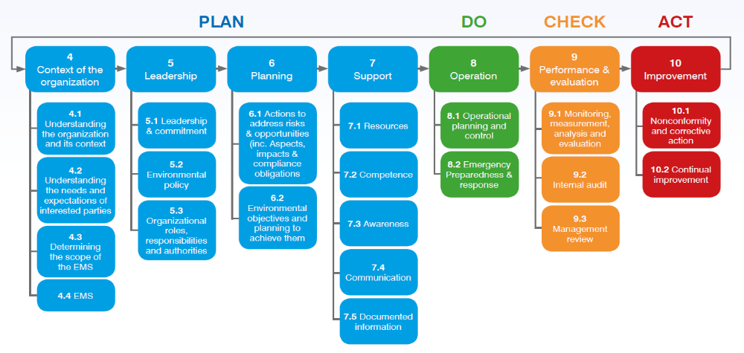
EMS REQUIREMENTS

Slide 19
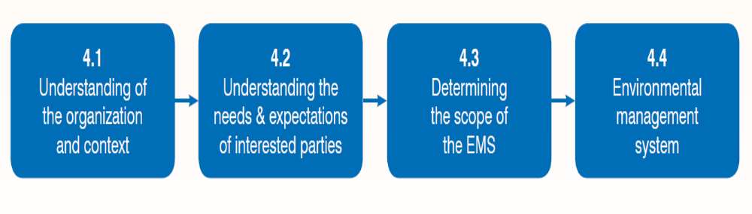
CONTEXT OF THE ORGANIZATION (4)-EMS REQUIREMENTS

Slide 20

CONTEXT OF THE ORGANIZATION (4)-EMS REQUIREMENTS
4.1 -Understanding the organization and its context
The organization shall determine external and internal issues that are relevant to its purpose and that affect its ability to achieve the intended outcomes of its environmental management system. Such issues shall include environmental conditions being affected by or capable of affecting the organization.

Slide 21
CONTEXT OF THE ORGANIZATION (4)-EMS REQUIREMENTS
Internal Context | External Context
Activities , processes ,products & services | Legal & other requirements
Strategic direction –action to achieve goal | Financial, technological ,economic ,nature & competitive context.
Existing technology | Competitiveness
Personnel Competency | Market situation
Culture & capabilities | Political, social and culture situation
People, knowledge ,systems | Economic environments International ,national ,regional or local.

Slide 22
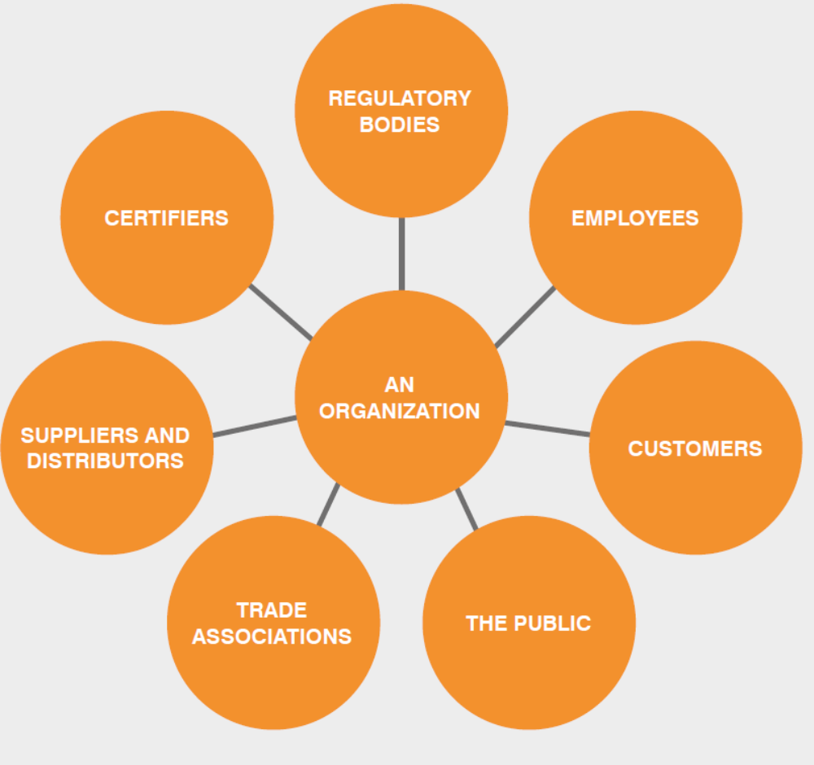
CONTEXT OF THE ORGANIZATION (4)-EMS REQUIREMENTS
4.2 Understanding the needs and expectations of interested parties
The organization shall determine:
a) the interested parties that are relevant to the environmental management system;
b) the relevant needs and expectations (i.e. requirements) of these interested parties;
c) which of these needs and expectations become its compliance obligations.

Slide 23
CONTEXT OF THE ORGANIZATION (4)-EMS REQUIREMENTS
4.2 Understanding the needs and expectations of interested parties
TYPE | INTRESTED PARTIES | NEED AND EXPECTATION OF INTRESTED PARTIES | NEED AND EXPECTATION OF THE ORGANIZATION
External | Customer | Follow all local law and Environment requirements | Customer satisfaction, good level and long term relationship
External | External Provider | Continuous order ,prompt payments as per agreed terms, | Loyalty to external provider
External | Community | Contribute positive to its local government and population. No complain relation to noise, pollution & waste. | Significance improvement in local environment.
Internal | Owner(partner/investors) | Profitability /good finance and legal compliance ,avoiding of fine or penalty | Good working atmosphere ,Develop and implement smooth business running polices
Internal | Staff | Continuous job, timely wages, professional development and training | 100% output, loyalty with the organization
Internal | Trade union | Effective implementation of national and local environment law and labor law | Smooth flow of production without any interpretation

Slide 24

CONTEXT OF THE ORGANIZATION (4)-EMS REQUIREMENTS
4.3 Determining the scope of the environmental management system
The organization shall determine the boundaries and applicability of the environmental management system to establish its scope.
When determining this scope, the organization shall consider:
a) the external and internal issues referred to in 4.1;
b) the compliance obligations referred to in 4.2;
c) its organizational units, functions and physical boundaries;
d) its activities, products and services;
e) its authority and ability to exercise control and influence.
Once the scope is defined, all activities, products and services of the organization within that scope need to be included in the environmental management system.
The scope shall be maintained as documented information and be available to interested parties.

Slide 25
CONTEXT OF THE ORGANIZATION (4)-EMS REQUIREMENTS
4.4 Environmental management system
To achieve the intended outcomes, including enhancing its environmental performance, the organization shall establish, implement, maintain and continually improve an environmental management system, including the processes needed and their interactions, in accordance with the requirements of this International Standard.
The organization shall consider the knowledge gained in 4.1 and 4.2 when establishing and maintaining the environmental management system.

Slide 26

LEADERSHIP (5)-EMS REQUIREMENTS
5.1 Leadership and commitment
Top management shall demonstrate leadership and commitment with respect to the environmental management system by:
a) taking accountability for the effectiveness of the environmental management system;
b) ensuring that the environmental policy and environmental objectives are established and are compatible with the strategic direction and the context of the organization;
c) ensuring the integration of the environmental management system requirements into the organization’s business processes;
d) ensuring that the resources needed for the environmental management system are available;
e) communicating the importance of effective environmental management and of conforming to the environmental management system requirements;

Slide 27
LEADERSHIP (5)-EMS REQUIREMENTS
5.1 Leadership and commitment (Cont..)
f) ensuring that the environmental management system achieves its intended outcomes;
g) directing and supporting persons to contribute to the effectiveness of the environmental management system;
h) promoting continual improvement;
i) supporting other relevant management roles to demonstrate their leadership as it applies to their areas of responsibility.

Slide 28
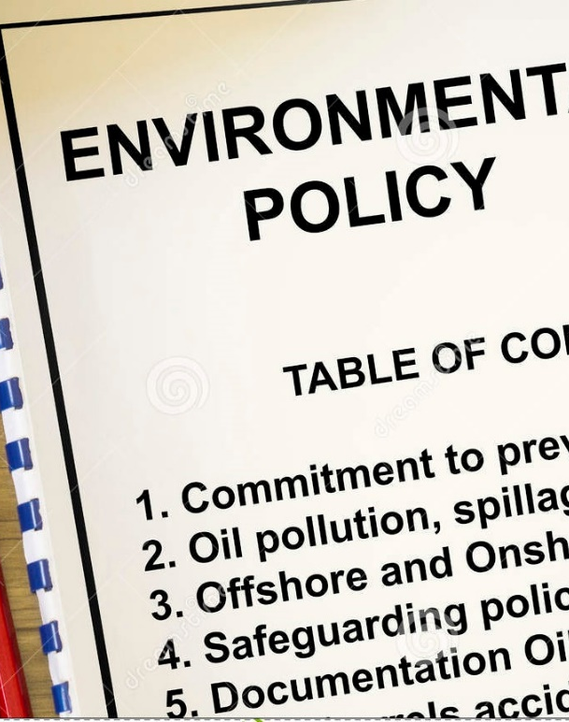
LEADERSHIP (5)-EMS REQUIREMENTS
5.2 Environmental policy
Top management shall establish, implement and maintain an environmental policy that, within the defined scope of its environmental management system:
a) is appropriate to the purpose and context of the organization, including the nature, scale and environmental impacts of its activities, products and services;
b) provides a framework for setting environmental objectives;
c) includes a commitment to the protection of the environment, including prevention of pollution and other specific commitment(s) relevant to the context of the organization;
d) includes a commitment to fulfil its compliance obligations;
e) includes a commitment to continual improvement of the environmental management system to enhance environmental performance.

Slide 29
LEADERSHIP (5)-EMS REQUIREMENTS
5.2 Environmental policy (Cont..)
The environmental policy shall:
be maintained as documented information;
be communicated within the organization;
be available to interested parties.

Slide 30
LEADERSHIP (5)-EMS REQUIREMENTS
5.3 Organizational roles, responsibilities and authorities
Top management shall ensure that the responsibilities and authorities for relevant roles are assigned and communicated within the organization.
Top management shall assign the responsibility and authority for:
a) ensuring that the environmental management system conforms to the requirements of this International Standard;
b) reporting on the performance of the environmental management system, including environmental performance, to top management.

Slide 31
LEADERSHIP (5)-EMS REQUIREMENTS
5.3 Organizational roles, responsibilities and authorities
Designation | Roles | Responsibilities | Authorities
Director -Technical | Defining business strategies Defining company policy in consultation with other directors Defining company objectives and targets in consultation with other directors and personal Chairs management review meetings Monitoring of other Activities which help in improving EMS | Responsible for implementation of business plans and strategies Responsible for hiring of personnel Responsible for training of personnel Responsible for performance activities Responsible for implementation of business plans and strategies | Finalization of business plans, strategies, company policy, objectives & targets Finalization of decisions taken in management review meetings Decisions for deviations in the performance Decision taken to implement any new technology

Slide 32

PLANNING (6)-EMS REQUIREMENTS
6.1 Actions to address risks and opportunities
6.1.1 General
The organization shall establish, implement and maintain the process(es) needed to meet the requirements in 6.1.1 to 6.1.4.
When planning for the environmental management system, the organization shall consider:
a) the issues referred to in 4.1;
b) the requirements referred to in 4.2;
c) the scope of its environmental management system;
and determine the risks and opportunities, related to its environmental aspects (see 6.1.2), compliance obligations (see 6.1.3) and other issues and requirements, identified in 4.1 and 4.2, that need to be addressed to:

Slide 33

PLANNING (6)-EMS REQUIREMENTS
6.1 Actions to address risks and opportunities
6.1.1 General (Cont..)
give assurance that the environmental management system can achieve its intended outcomes;
prevent or reduce undesired effects, including the potential for external environmental conditions to affect the organization;
achieve continual improvement
Within the scope of the environmental management system, the organization shall determine potential emergency situations, including those that can have an environmental impact.
The organization shall maintain documented information of its:
risks and opportunities that need to be addressed;
process(es) needed in 6.1.1 to 6.1.4, to the extent necessary to have confidence they are carried out as planned.

Slide 34

PLANNING (6)-EMS REQUIREMENTS
6.1.2 Environmental aspects
Within the defined scope of the environmental management system, the organization shall determine the environmental aspects of its activities, products and services that it can control and those that it can influence, and their associated environmental impacts, considering a life cycle perspective.
When determining environmental aspects, the organization shall take into account:
a) change, including planned or new developments, and new or modified activities, products and services;
b) abnormal conditions and reasonably foreseeable emergency situations.

Slide 35
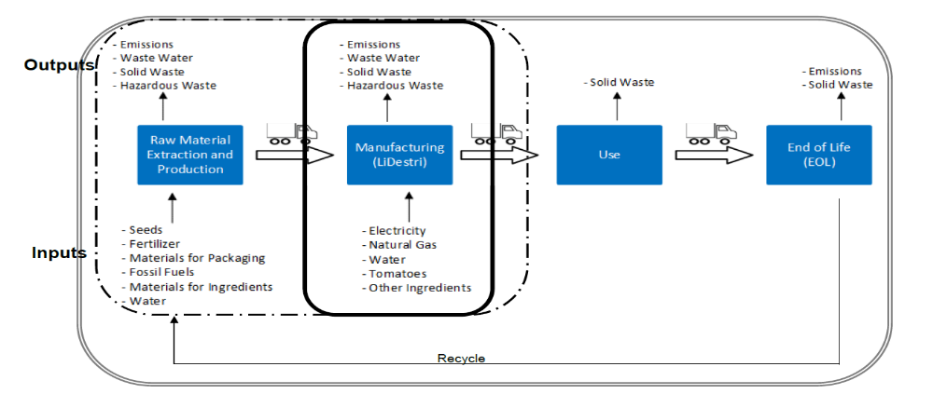
PLANNING (6)-EMS REQUIREMENTS
LIFE CYCLE APPROACH

Slide 36
PLANNING (6)-EMS REQUIREMENTS
6.1.2 Environmental aspects( Cont..)
The organization shall determine those aspects that have or can have a significant environmental impact, i.e. significant environmental aspects, by using established criteria.
The organization shall communicate its significant environmental aspects among the various levels and functions of the organization, as appropriate.
The organization shall maintain documented information of its:
environmental aspects and associated environmental impacts;
criteria used to determine its significant environmental aspects;
significant environmental aspects.
NOTE Significant environmental aspects can result in risks and opportunities associated with either adverse environmental impacts (threats) or beneficial environmental impacts (opportunities).

Slide 37
PLANNING (6)-EMS REQUIREMENTS
6.1.3 Compliance obligations
The organization shall:
a) determine and have access to the compliance obligations related to its environmental aspects;
b) determine how these compliance obligations apply to the organization;
c) take these compliance obligations into account when establishing, implementing, maintaining and continually improving its environmental management system.
The organization shall maintain documented information of its compliance obligations.
NOTE Compliance obligations can result in risks and opportunities to the organization.

Slide 38

PLANNING (6)-EMS REQUIREMENTS
6.1.4 Planning action
he organization shall plan:
a) to take actions to address its:
1) significant environmental aspects;
2) compliance obligations;
3) risks and opportunities identified in 6.1.1;
b) how to:
1) integrate and implement the actions into its environmental management system processes (see 6.2, Clause 7, Clause 8 and 9.1), or other business processes;
2) evaluate the effectiveness of these actions (see 9.1).
When planning these actions, the organization shall consider its technological options and its financial, operational and business requirements.

Slide 39
PLANNING (6)-EMS REQUIREMENTS
6.2 Environmental objectives and planning to achieve them
6.2.1 Environmental objectives
The organization shall establish environmental objectives at relevant functions and levels, taking into account the organization’s significant environmental aspects and associated compliance obligations, and considering its risks and opportunities.
The environmental objectives shall be:
a) consistent with the environmental policy;
b) measurable (if practicable);
c) monitored;
d) communicated;
e) updated as appropriate.
The organization shall maintain documented information on the environmental objectives

Slide 40
PLANNING (6)-EMS REQUIREMENTS
6.2.2 Planning actions to achieve environmental objectives
When planning how to achieve its environmental objectives, the organization shall determine:
a) what will be done;
b) what resources will be required;
c) who will be responsible;
d) when it will be completed;
e) how the results will be evaluated, including indicators for monitoring progress toward achievement of its measurable environmental objectives (see 9.1.1).
The organization shall consider how actions to achieve its environmental objectives can be integrated into the organization’s business processes

Slide 41

SUPPORT (7)-EMS REQUIREMENTS
7.1 Resources
The organization shall determine and provide the resources needed for the establishment, implementation, maintenance and continual improvement of the environmental management system.
7.2 Competence
The organization shall:
a) determine the necessary competence of person(s) doing work under its control that affects its
environmental performance and its ability to fulfil its compliance obligations;
b) ensure that these persons are competent on the basis of appropriate education, training or experience;
c) determine training needs associated with its environmental aspects and its environmental management system;

Slide 42

SUPPORT (7)-EMS REQUIREMENTS
7.2 Competence (Cont..)
The organization shall:
d) where applicable, take actions to acquire the necessary competence, and evaluate the effectiveness
of the actions taken.
NOTE Applicable actions can include, for example, the provision of training to, the mentoring of, or the reassignment of currently employed persons; or the hiring or contracting of competent persons.
The organization shall retain appropriate documented information as evidence of competence.

Slide 43

SUPPORT (7)-EMS REQUIREMENTS
7.3 Awareness
The organization shall ensure that persons doing work under the organization’s control are aware of:
a) the environmental policy;
b) the significant environmental aspects and related actual or potential environmental impacts associated with their work;
c) their contribution to the effectiveness of the environmental management system, including the benefits of enhanced environmental performance;
d) the implications of not conforming with the environmental management system requirements, including not fulfilling the organization’s compliance obligations.

Slide 44

SUPPORT (7)-EMS REQUIREMENTS
7.4 Communication
7.4.1 General
The organization shall establish, implement and maintain the process(es) needed for internal and external communications relevant to the environmental management system, including:
a) on what it will communicate;
b) when to communicate;
c) with whom to communicate;
d) how to communicate.
When establishing its communication process(es), the organization shall:
take into account its compliance obligations;
ensure that environmental information communicated is consistent with information generated within the environmental management system, and is reliable.

Slide 45

SUPPORT (7)-EMS REQUIREMENTS
7.4 Communication
7.4.1 General
The organization shall establish, implement and maintain the process(es) needed for internal and external communications relevant to the environmental management system, including:
a) on what it will communicate;
b) when to communicate;
c) with whom to communicate;
d) how to communicate.
When establishing its communication process(es), the organization shall:
take into account its compliance obligations;
ensure that environmental information communicated is consistent with information generated within the environmental management system, and is reliable..

Slide 46

SUPPORT (7)-EMS REQUIREMENTS
7.4 Communication
7.4.1 General
The organization shall respond to relevant communications on its environmental management system.
he organization shall retain documented information as evidence of its communications, as appropriate
7.4.2 Internal communication
The organization shall:
a) internally communicate information relevant to the environmental management system among the various levels and functions of the organization, including changes to the environmental system, as appropriate;
b) ensure its communication process(es) enable(s) persons doing work under the organization’s control to contribute to continual improvement.

Slide 47

SUPPORT (7)-EMS REQUIREMENTS
7.4.3 External communication
The organization shall externally communicate information relevant to the environmental management system, as established by the organization’s communication process(es) and as required by its compliance obligations.

Slide 48

SUPPORT (7)-EMS REQUIREMENTS
7.5 Documented information
7.5.1 General
The organization’s environmental management system shall include:
a) documented information required by this International Standard;
b) documented information determined by the organization as being necessary for the effectiveness f the environmental management system.
NOTE The extent of documented information for an environmental management system can differ from one organization to another due to:
the size of organization and its type of activities, processes, products and services;
the need to demonstrate fulfilment of its compliance obligations;
the complexity of processes and their interactions;
the competence of persons doing work under the organization’s control.

Slide 49

SUPPORT (7)-EMS REQUIREMENTS
7.5.2 Creating and updating
When creating and updating documented information, the organization shall ensure appropriate:
a) identification and description (e.g. a title, date, author, or reference number);
b) format (e.g. language, software version, graphics) and media (e.g. paper, electronic);
c) review and approval for suitability and adequacy.
7.5.3 Control of documented information
Documented information required by the environmental management system and by this International Standard shall be controlled to ensure:
a) it is available and suitable for use, where and when it is needed;

Slide 50

SUPPORT (7)-EMS REQUIREMENTS
7.5.3 Control of documented information (Cont..)
b) it is adequately protected (e.g. from loss of confidentiality, improper use, or loss of integrity).
For the control of documented information, the organization shall address the following activities as applicable:
distribution, access, retrieval and use;
storage and preservation, including preservation of legibility;
control of changes (e.g. version control);
retention and disposition.
Documented information of external origin determined by the organization to be necessary for the planning and operation of the environmental management system shall be identified, as appropriate, and controlled.
NOTE Access can imply a decision regarding the permission to view the documented information only, or the permission and authority to view and change the documented information.

Slide 51

OPERATION(8)-EMS REQUIREMENTS
8.1 Operational planning and control
The organization shall establish, implement, control and maintain the processes needed to meet environmental management system requirements, and to implement the actions identified in 6.1 and 6.2, by:
establishing operating criteria for the process(es);
implementing control of the process(es), in accordance with the operating criteria.
NOTE Controls can include engineering controls and procedures. Controls can be implemented following a hierarchy (e.g. elimination, substitution, administrative) and can be used individually or in combination.
The organization shall control planned changes and review the consequences of unintended changes, taking action to mitigate any adverse effects, as necessary.

Slide 52

OPERATION(8)-EMS REQUIREMENTS
8.1 Operational planning and control (Cont..)
The organization shall ensure that outsourced processes are controlled or influenced. The type and
extent of control or influence to be applied to the process(es) shall be defined within the environmental management system.
Consistent with a life cycle perspective, the organization shall:
a) establish controls, as appropriate, to ensure that its environmental requirement(s) is (are) addressed
in the design and development process for the product or service, considering each life cycle stage;
b) determine its environmental requirement(s) for the procurement of products and services, as
appropriate;
c) communicate its relevant environmental requirement(s) to external providers, including contractors;
d) consider the need to provide information about potential significant environmental impacts
associated with the transportation or delivery, use, end-of-life treatment and final disposal of its
products and services.
The organization shall maintain documented information to the extent necessary to have confidence that the processes have been carried out as planned.

Slide 53
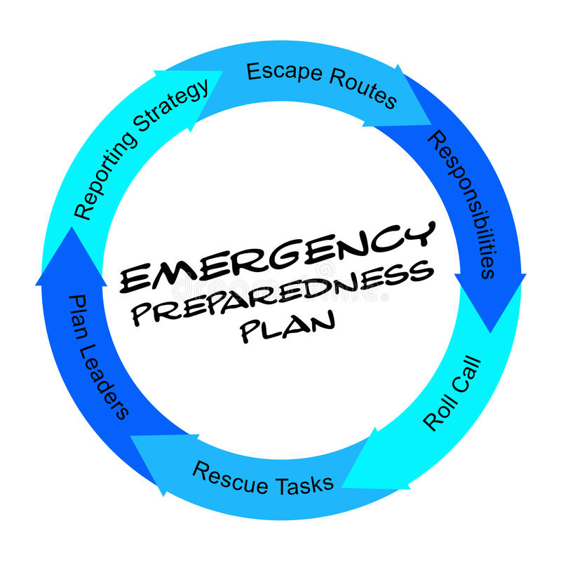
OPERATION(8)-EMS REQUIREMENTS
8.2 Emergency preparedness and response
The organization shall establish, implement and maintain the process(es) needed to prepare for and respond to potential emergency situations identified in 6.1.1.
The organization shall:
prepare to respond by planning actions to prevent or mitigate adverse environmental impacts from emergency situations;
b) respond to actual emergency situations;
c) take action to prevent or mitigate the consequences of emergency situations, appropriate to the magnitude of the emergency and the potential environmental impact;
d) periodically test the planned response actions, where practicable;

Slide 54

OPERATION(8)-EMS REQUIREMENTS
8.2 Emergency preparedness and response (Cont..)
e) periodically review and revise the process(es) and planned response actions, in particular after the occurrence of emergency situations or tests;
f) provide relevant information and training related to emergency preparedness and response, as appropriate, to relevant interested parties, including persons working under its control.
The organization shall maintain documented information to the extent necessary to have confidence that the process(es) is (are) carried out as planned.

Slide 55

PERFORMANCE EVALUATION (9)-EMS REQUIRMENTS
9.1 Monitoring, measurement, analysis and evaluation
9.1.1 General
The organization shall monitor, measure, analyse and evaluate its environmental performance.
The organization shall determine:
a) what needs to be monitored and measured;
b) the methods for monitoring, measurement, analysis and evaluation, as applicable, to ensure valid results;
c) the criteria against which the organization will evaluate its environmental performance, and appropriate indicators;
d) when the monitoring and measuring shall be performed;

Slide 56

PERFORMANCE EVALUATION (9)-EMS REQUIRMENTS
9.1.1 General (Cont..)
The organization shall ensure that calibrated or verified monitoring and measurement equipment is used and maintained, as appropriate.
The organization shall evaluate its environmental performance and the effectiveness of the environmental management system.
The organization shall communicate relevant environmental performance information both internally and externally, as identified in its communication process(es) and as required by its compliance obligations.
The organization shall retain appropriate documented information as evidence of the monitoring, measurement, analysis and evaluation results.

Slide 57

PERFORMANCE EVALUATION (9)-EMS REQUIRMENTS
9.1.2 Evaluation of compliance
The organization shall establish, implement and maintain the process(es) needed to evaluate fulfilment of its compliance obligations.
The organization shall:
a) determine the frequency that compliance will be evaluated;
b) evaluate compliance and take action if needed;
c) maintain knowledge and understanding of its compliance status.
The organization shall retain documented information as evidence of the compliance evaluation result(s).

Slide 58
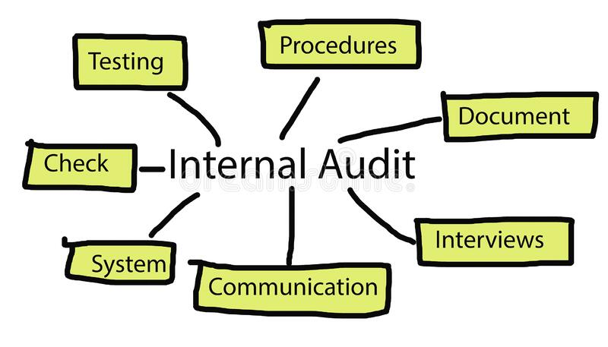
PERFORMANCE EVALUATION (9)-EMS REQUIRMENTS
9.2 Internal audit
9.2.1 General
The organization shall conduct internal audits at planned intervals to provide information on whether the environmental management system:
a) conforms to:
1) the organization’s own requirements for its environmental management system;
2) the requirements of this International Standard;
b) is effectively implemented and maintained.

Slide 59

PERFORMANCE EVALUATION (9)-EMS REQUIRMENTS
9.2.2 Internal audit programme
The organization shall establish, implement and maintain (an) internal audit programme(s), including the frequency, methods, responsibilities, planning requirements and reporting of its internal audits.
When establishing the internal audit programme, the organization shall take into consideration the environmental importance of the processes concerned, changes affecting the organization and the results of previous audits.
The organization shall:
a) define the audit criteria and scope for each audit;

Slide 60
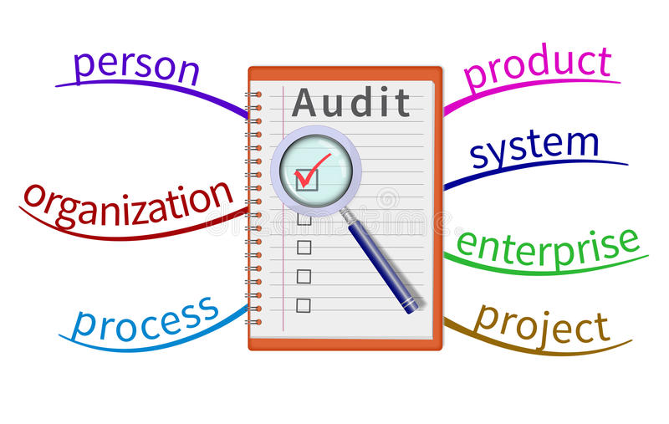
PERFORMANCE EVALUATION (9)-EMS REQUIRMENTS
9.2.2 Internal audit programme(Cont..)
b) select auditors and conduct audits to ensure objectivity and the impartiality of the audit process;
c) ensure that the results of the audits are reported to relevant management.
The organization shall retain documented information as evidence of the implementation of the audit Programme and the audit results.

Slide 61

PERFORMANCE EVALUATION (9)-EMS REQUIRMENTS
9.3 Management review
Top management shall review the organization’s environmental management system, at planned intervals, to ensure its continuing suitability, adequacy and effectiveness.
The management review shall include consideration of:
a) the status of actions from previous management reviews;
b) changes in:
1) external and internal issues that are relevant to the environmental management system;
2) the needs and expectations of interested parties, including compliance obligations;
3) its significant environmental aspects;
4) risks and opportunities;

Slide 62

PERFORMANCE EVALUATION (9)-EMS REQUIRMENTS
9.3 Management review (Cont..)
c) the extent to which environmental objectives have been achieved;
d) information on the organization’s environmental performance, including trends in:
1) nonconformities and corrective actions;
2) monitoring and measurement results;
3) fulfilment of its compliance obligations;
4) audit results;
e) adequacy of resources;
f) relevant communication(s) from interested parties, including complaints;
g) opportunities for continual improvement.

Slide 63

PERFORMANCE EVALUATION (9)-EMS REQUIRMENTS
9.3 Management review (Cont..)
The outputs of the management review shall include:
conclusions on the continuing suitability, adequacy and effectiveness of the environmental management system;
decisions related to continual improvement opportunities;
decisions related to any need for changes to the environmental management system, includingresources;
actions, if needed, when environmental objectives have not been achieved;
opportunities to improve integration of the environmental management system with other business processes, if needed;
any implications for the strategic direction of the organization.
The organization shall retain documented information as evidence of the results of management reviews.

Slide 64
IMPROVEMENT (10)-EMS REQUIRMENT
10.1 General
The organization shall determine opportunities for improvement (see 9.1, 9.2 and 9.3) and implement necessary actions to achieve the intended outcomes of its environmental management system.
10.2 Nonconformity and corrective action
When a nonconformity occurs, the organization shall:
a) react to the nonconformity and, as applicable:
1) take action to control and correct it;
2) deal with the consequences, including mitigating adverse environmental impacts;

Slide 65

IMPROVEMENT (10)-EMS REQUIRMENT
10.2 Nonconformity and corrective action(Cont..)
b) evaluate the need for action to eliminate the causes of the nonconformity, in order that it does not recur or occur elsewhere, by:
1) reviewing the nonconformity;
2) determining the causes of the nonconformity;
3) determining if similar nonconformities exist, or could potentially occur;
c) implement any action needed;
d) review the effectiveness of any corrective action taken;
e) make changes to the environmental management system, if necessary.
Corrective actions shall be appropriate to the significance of the effects of the nonconformities encountered, including the environmental impact(s).
The organization shall retain documented information as evidence of:
the nature of the nonconformities and any subsequent actions taken;
the results of any corrective action.

Slide 66

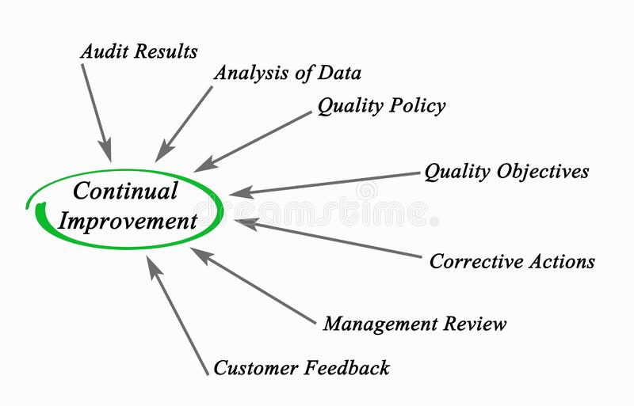
IMPROVEMENT (10)-EMS REQUIRMENT
10.3 Continual improvement
The organization shall continually improve the suitability, adequacy and effectiveness of the environmental management system to enhance environmental performance.

Slide 67

THANK YOU

